Slide 1
MySQL Database
Course
Database Management System Lab
Presented by :
Roll Number Name
23358 Devraj Thakkar
23359 Samir Thokal
23360 Sahil Tiwade
23361 Dhiraj Wadile

Slide 2

Contents
Introduction
History and Evolution
Characteristics
Architecture
Efficiency, Scalability, Performance
Applications
Real-time usage
Conclusion
References

Slide 3
Introduction
MySQL is the most popular Open-Source Relational SQL Database Management System.
It is one of the best Relational DBMS (RDBMS) being used for developing web-based software applications.
MySQL was developed and marketed by MySQL AB, which is a swedish company.

Slide 4

History and Evolution
MySQL was created by a Swedish company, MySQL AB.
founded by Swedes David Axmark, Allan Larsson and Finland Swede Michael "Monty" Widenius
Original development of MySQL began in 1994.
The first version of MySQL appeared on 23 May 1995.

Slide 5
Characteristics
Easy to use.
MySQL is an open-source database.
MySQL is customizable because it is an open source.
It is faster than other databases so it can work well even with large data sets
It supports various programming languages like PERL, PHP, C++, JAVA, etc.
MySQL uses a standard form of the well-known SQL (Structured Query Language).
MySQL is secure because it is updated regularly and has vibrant developer community.
It is reliable.

Slide 6
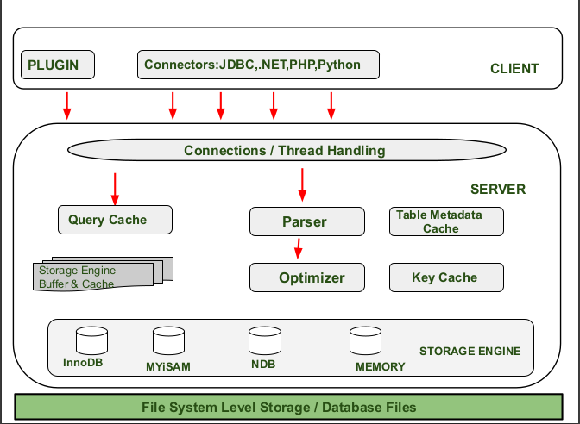
Architecture

Slide 7
Layers of MySQL Architecture
Client
Server
Storage Layer
Client make request by using valid MYSQL commands and expressions.
Some important services of client layer are :
Connection Handling.
Authentication.
Security.
responsible for all logical functionalities of relational database management system.
When the Client give request instructions to the Server and the server gives the output as soon as the instruction is matched.
These are MySQL components that handle the SQL operations for different table types.
InnoDB is the default and most general-purpose storage engine, and Oracle recommends using it for tables.
Other examples are MYiSAM , NDB ,Memory etc

Slide 8
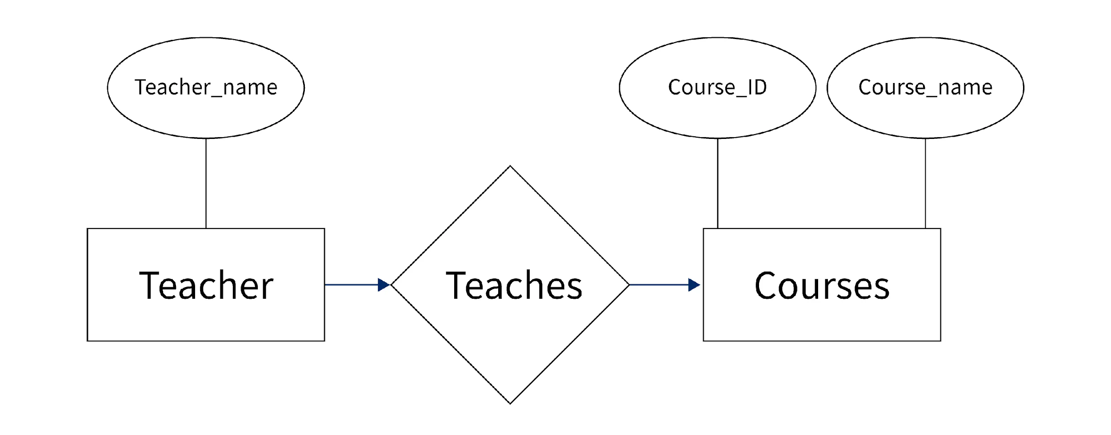
ER diagram
ERD is a diagram that displays the relationship of entity sets stored in a database.
ER diagrams help to explain the logical structure of databases.
Example of ER diagram :

Slide 9
Features of MySQL
Efficiency of MySQL
MySQL queries achieve efficiency by generating a smaller table called an index; from a specified columns or a set of columns.
Scalability of MySQL
MySQL supports large databases with upto 50 million rows in a table.
The default file size is 4GB which can be extended upto 8 million terabytes (TB).
Performance of MySQL
Proper indexing of tables can significantly improve the performance of MySQL.
Query optimization is critical for improving MySQL performance.

Slide 10

Applications of MySQL database
Web applications
Business applications
Mobile applications
Gaming applications
Data warehousing and analytics
Embedded systems

Slide 11
Real-time usage of MySQL
Websites: MySQL is used to store and manage data for many popular websites, such as Facebook, Twitter, YouTube, and Wikipedia.
Online transactions: MySQL is used to process online transactions, such as e-commerce transactions, banking transactions, and stock trading transactions.
Social media: MySQL is used to store and manage user data and social connections in social media platforms, such as Facebook, Instagram, and LinkedIn.
Internet of Things (IoT): MySQL is used in IoT applications to store and manage sensor data from various devices and sensors, such as smart home devices, wearables, and industrial sensors.
Financial services: MySQL is used in financial applications to store and manage data related to financial transactions, such as credit card transactions, loans, and investment portfolios.
Healthcare: MySQL is used in healthcare applications to store and manage patient data, medical records, and other related information..

Slide 12
Conclusion
Conclusion
MySQL is a popular open-source relational database management system that offers several advantages over various other database management systems. One of the main advantages of MySQL is its flexibility and scalability, allowing it to handle large amounts of data and complex queries. It also provides strong data security features, including encryption and access control, which are essential for protecting sensitive data.

Slide 13
References
https://www.talend.com/resources/what-is-mysql/
https://www.javatpoint.com/what-is-database
https://en.wikipedia.org/wiki/MySQL
https://www.openlogic.com/blog/mysql-overview
https://www.guru99.com/er-diagram-tutorial-dbms.html

Slide 14
THANK YOU

